Slide 1





Middle Income Status- A Possibility or Impossibility for Ethiopia.
Introduction
Agriculture
Manufacturing
Services
Foreign Market
Arpan Das
M.Sc. Economics (22060242014)
Analysis
Population
Conclusion
Currency

Slide 2
A little game for all!
Introduction
Agriculture
Manufacturing
Services
Foreign Market
Count the number of apples hidden throughout the presentation.
Analysis
Population
Conclusion
Currency

Slide 3
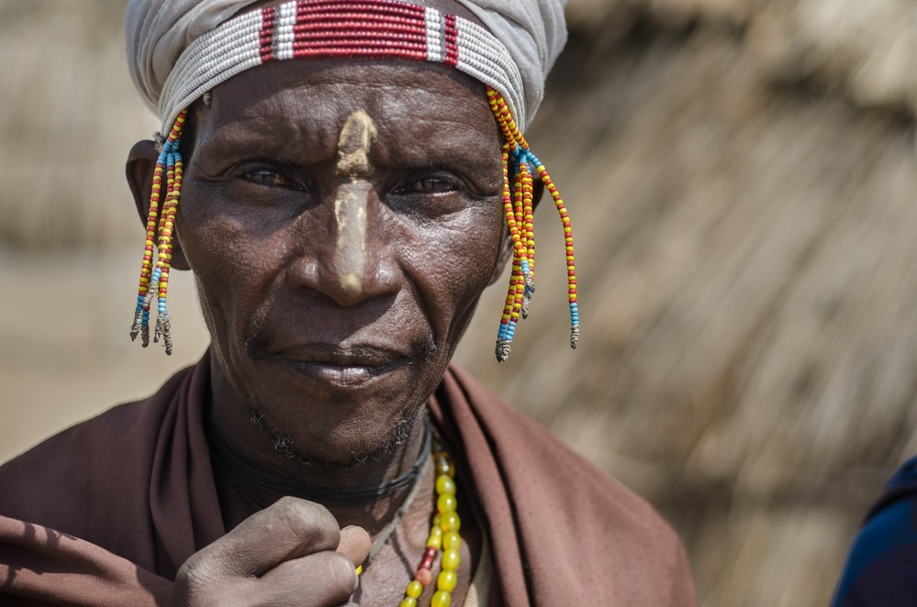

Middle Income Status- A Possibility or Impossibility for Ethiopia.
Agriculture
Manufacturing
Introduction
Services
Population
Analysis
Arpan Das
M.Sc. Economics (22060242014)
Imports and Exports
Conclusion
Africa’s oldest independent country
Continent’s 2nd most populus economy with over 100 million people residing here.
Traditionally- Agro based Economy.
1960’s- Liberalization.
1970’s- Social Unrest, Coup attempts leading to formation of Eretria in 1993.
Mid 1990’s- Started focusing on development.
Experienced 10% Economic growth rate for past 15 years.
However, GDP Per Capita still low - $960 in 2022.
Government started a 10 year development plan in 2019 focusing on SDG Metrics.

Slide 4
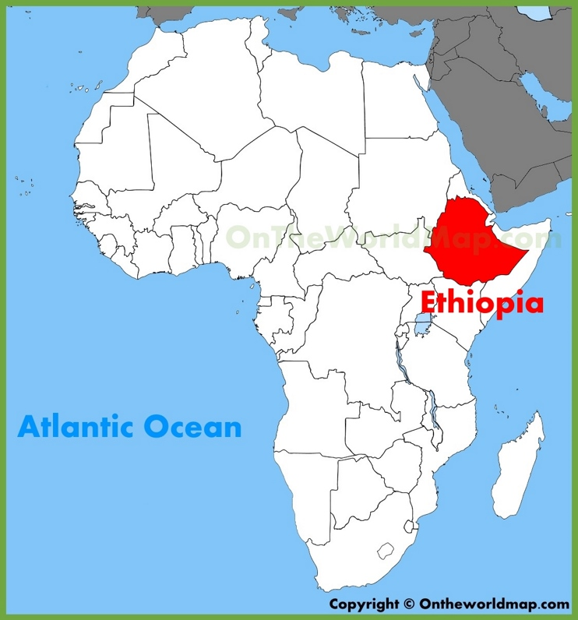
Middle Income Status- A Possibility or Impossibility for Ethiopia.
Idea for Research.
Introduction
Africa’s oldest independent country
Continent’s 2nd most populus economy with over 100 million people residing here.
Traditionally- Agro based Economy.
1960’s- Liberalization.
1970’s-Social Unrest, Coup attempts leading to formation of Eretria in 1993.
Mid 1990’s- Started focusing on development.
Experienced 10% Economic growth rate for past 15 years.
However, GDP Per Capita still low - $960 in 2022.
Government started a 10 year development plan in 2019 focusing on SDG Metrics.
Arpan Das
M.Sc. Economics (22060242014)

Slide 5

Middle Income Status- A Possibility or Impossibility for Ethiopia.
Idea for Research.
Ethiopia- Still an LDC
GDP Per Capita- $960 as of 2022.
“Part” of BRICS- Only LDC which will be a part of BRICS.
Key player in African Politics.
Geo-strategic location.
To reach Middle Income- GDPPC should be $1036.
Arpan Das
M.Sc. Economics (22060242014)
World Bank- Claims Ethiopia will reach middle income status by 2025!!

Slide 6
Middle Income Status- A Possibility or Impossibility for Ethiopia.
Agriculture
Manufacturing
Introduction
Services
Population
Analysis
Arpan Das
M.Sc. Economics (22060242014)
Imports and Exports
Conclusion
Africa’s oldest independent country
Continent’s 2nd most populus economy with over 100 million people residing here.
Traditionally- Agro based Economy.
1960’s- Liberalization.
1970’s- Social Unrest, Coup attempts leading to formation of Eretria in 1993.
Mid 1990’s- Started focusing on development.
Experienced 10% Economic growth rate for past 15 years.
However, GDP Per Capita still low - $960 in 2022.
Government started a 10 year development plan in 2019 focusing on SDG Metrics.

Slide 7
Middle Income Status- A Possibility or Impossibility for Ethiopia.
Idea for Research.
Analysis
This analysis has 3 main components: 1. Forecasting GDP Per Capita via CAGR analysis. 2. Time Series Econometrics. 3. Visualizing KPI on a dashboard to make the analysis user-friendly.
Arpan Das
M.Sc. Economics (22060242014)
Years | Forecast(GDPPC) | Lower Confidence Bound(GDPPC) | Upper Confidence Bound(GDPPC) | Probability
2023 | 996.43 | 931.50 | 1061.35 | 39.05
2024 | 1032.51 | 915.62 | 1149.40 | 97.01
2025 | 1068.59 | 894.08 | 1243.11 | 100

Slide 8
Middle Income Status- A Possibility or Impossibility for Ethiopia.
Idea for Research.
Forecasting GDP Per Capita - CAGR analysis
CAGR- 3.84%
Arpan Das
M.Sc. Economics (22060242014)
Years | Forecast(GDPPC) | Lower Confidence Bound(GDPPC) | Upper Confidence Bound(GDPPC) | Probability
2023 | 996.43 | 931.50 | 1061.35 | 39.05
2024 | 1032.51 | 915.62 | 1149.40 | 97.01
2025 | 1068.59 | 894.08 | 1243.11 | 100
Yes, Ethiopia will reach Middle Income status by 2025!!

Slide 9
Middle Income Status- A Possibility or Impossibility for Ethiopia.
Analysis
Idea for Research.
Forecasting GDP Per Capita via CAGR analysis
Yes, Ethiopia will reach Middle Income status by 2025!!
Arpan Das
M.Sc. Economics (22060242014)

Slide 10
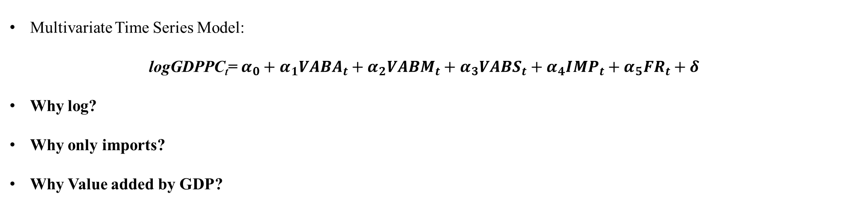
Middle Income Status- A Possibility or Impossibility for Ethiopia.
Analysis
Idea for Research.
Time Series Econometrics.
Multivariate Time Series Model:
logGDPPC_{t}= $α_{0}+α_{1}{VABA}_{t}+α_{2}{VABM}_{t}+α_{3}{VABS}_{t}+α_{4}{IMP}_{t}+α_{5}{FR}_{t}+δ$
Why log?
Why only imports?
Why Value added by GDP?
Sr No. | Variable name | Variable Abbreviation. | Variable Abbreviation (For Simplicity)
 | GDP Per capita | logGDPPC | logGDPPC
2. | Value Added by Agriculture by GDP | ValueAddedbyagripartofGDP | VABA
3. | Value Added by Services by GDP | ValueAddedbyservicepartofG | VABS
4. | Value Added by Manufacturing by GDP | ValueAddedbymanupartofGDP | VABM
5. | Fertility Rate | FertilityRate | FR
6. | Imports by GDP | ImportsbyGDP | IMP
Arpan Das
M.Sc. Economics (22060242014)

Slide 11
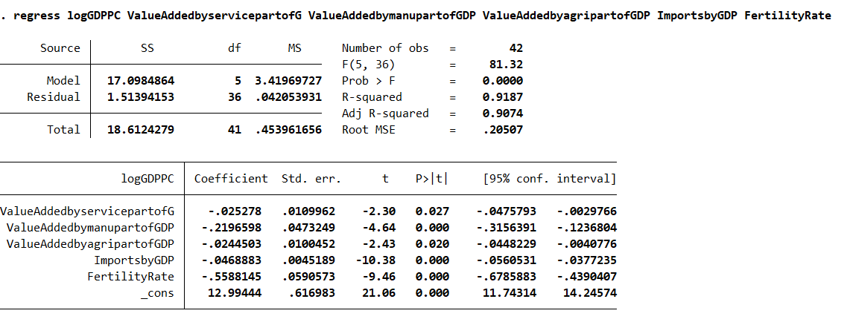
Middle Income Status- A Possibility or Impossibility for Ethiopia.
Analysis
Idea for Research.
Time Series Econometrics.
Arpan Das
M.Sc. Economics (22060242014)

Slide 12
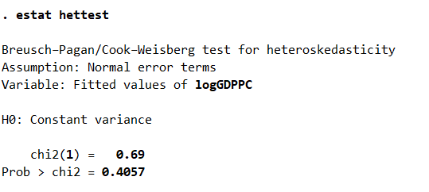
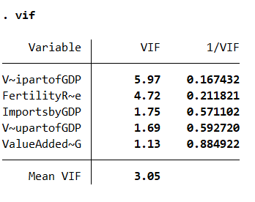


Middle Income Status- A Possibility or Impossibility for Ethiopia.
Analysis
Idea for Research.
Time Series Econometrics.
- No Multicolinearity (As only Imports used)
- No Heteroscedasticity (Value added by GDP used)
- Autocorrelation present
Arpan Das
M.Sc. Economics (22060242014)
Presence of Positive Autocorrelation

Slide 13
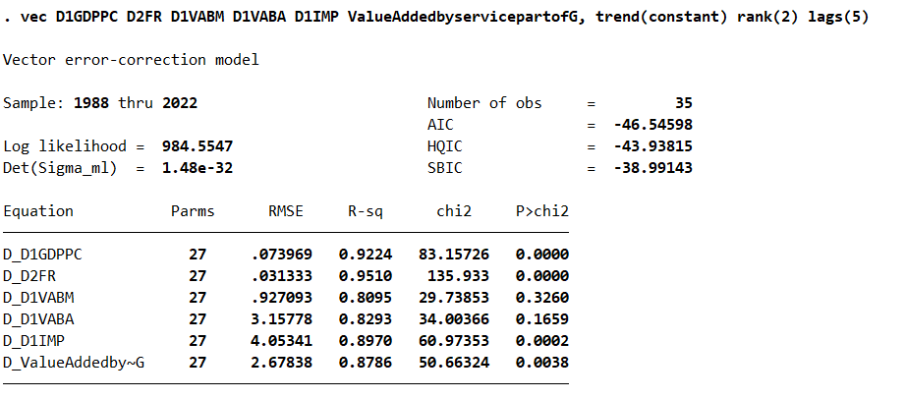
Middle Income Status- A Possibility or Impossibility for Ethiopia.
Analysis
Idea for Research.
Time Series Econometrics.
Stationarity check- ADF test.
Only Fertility Rate was stable at t-2 levels.
Rest were stable at t-1 level.
Trace Statistic- 2 (VECM Model used)
Optimal Lag length- 5.
Arpan Das
M.Sc. Economics (22060242014)

Slide 14
Middle Income Status- A Possibility or Impossibility for Ethiopia.
Analysis
Idea for Research.
Time Series Econometrics.
Variable (Dependent) | Variable (Independent) | Coefficient | z value | P>= |z|
D_D2FR
 | D1GDPPC | -1.387674 | -3.36 | 0.001
 | ValueAddedbyservicepartofGDP | -0.045102 | -3.45 | 0.001
D_D1VABA
 | D1GDPPC | 93.94956 | 2.25 | 0.024
Arpan Das
M.Sc. Economics (22060242014)
Points to notice (In terms of relation):
GDP Per Capita has negative relation with Fertility Rate.
Fertility Rate has negative relation with Value added in Services.
Value added by Agriculture has a positive relation with GDP Per Capita

Slide 15
Middle Income Status- A Possibility or Impossibility for Ethiopia.
Analysis
Idea for Research.
Time Series Econometrics.
However model suggests something different.
FR (t-2) = -1.39*GDPPC(t-1) – 0.05*VABS (t).
VABA (t-1) = 93.95* GDPDC (t-1).
This means fertility rate is dependent on the GDP Per Capita and the Services sector value added by Ethiopia.
Why?
Efficiency is the answer- Nations with inefficient labors have some of the highest fertility rates.
Ethiopia has a booming Services sector which accounts for roughly 38% of value added in GDP.
Services sector:
Higher Pay – Having Kids affordable – Not good for the GDP Per capita.
However, agriculture still is biggest sector to input value into the Ethiopian Economy (Roughly 56%).
Arpan Das
M.Sc. Economics (22060242014)

Slide 16

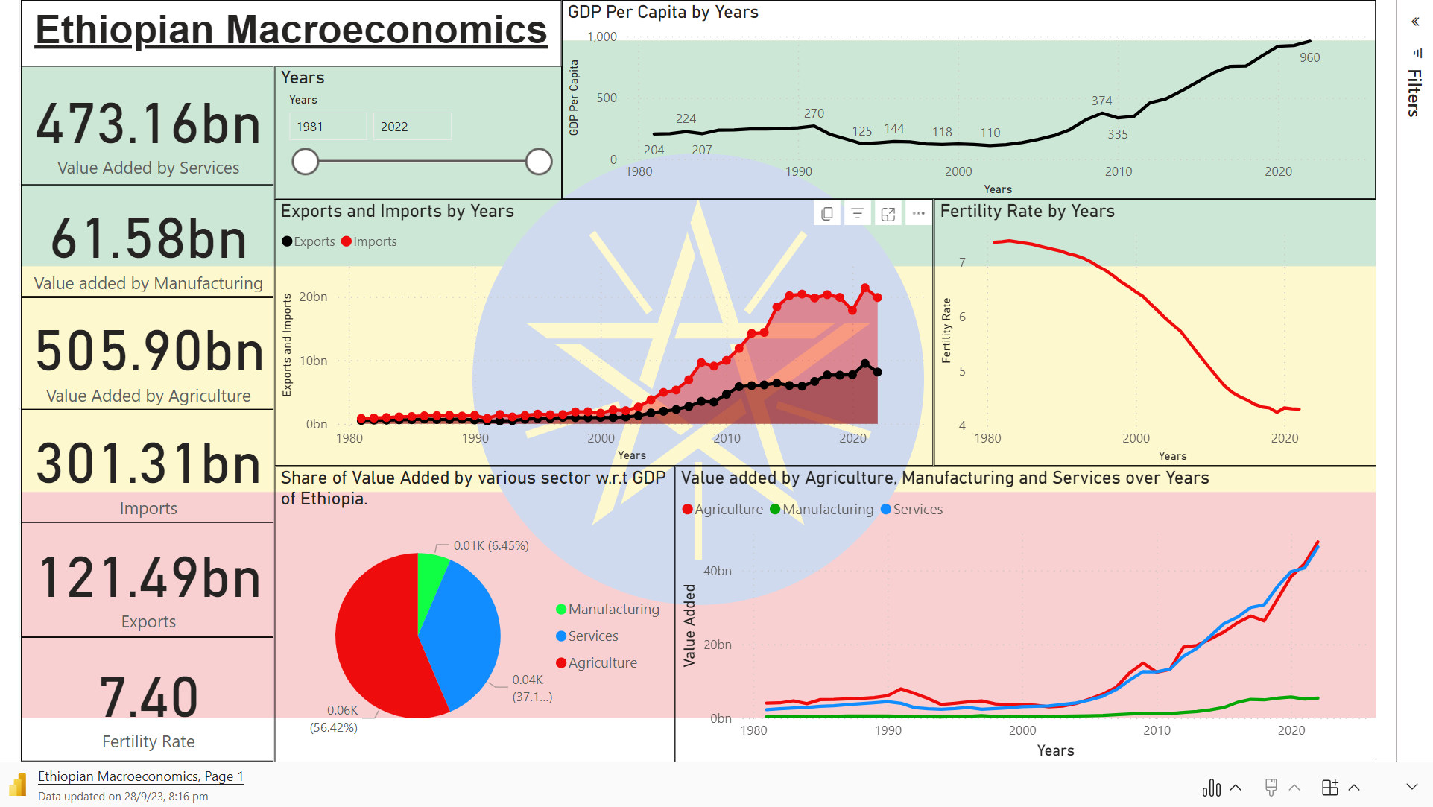
Microsoft Power BI

Slide 17
Middle Income Status- A Possibility or Impossibility for Ethiopia.
Agriculture
Manufacturing
Introduction
Services
Population
Analysis
Arpan Das
M.Sc. Economics (22060242014)
Imports and Exports
Conclusion
Africa’s oldest independent country
Continent’s 2nd most populus economy with over 100 million people residing here.
Traditionally- Agro based Economy.
1960’s- Liberalization.
1970’s- Social Unrest, Coup attempts leading to formation of Eretria in 1993.
Mid 1990’s- Started focusing on development.
Experienced 10% Economic growth rate for past 15 years.
However, GDP Per Capita still low - $960 in 2022.
Government started a 10 year development plan in 2019 focusing on SDG Metrics.

Slide 18
Middle Income Status- A Possibility or Impossibility for Ethiopia.
Idea for Research.
Conclusion
Still an Agro-based Economy with a booming services sector.
High Fertility rates- Matter of Concern.
Manufacturing sector needs boost- Government started a 10 year development plan in 2019 focusing on SDG Metrics.
At current situation- Ethiopia will reach Middle Income status by 2025.
Arpan Das
M.Sc. Economics (22060242014)

Slide 19
So…..
Introduction
Agriculture
Manufacturing
Services
Foreign Market
How many were there??
Analysis
Population
Conclusion
Currency
4
Still an Agro-based Economy with a booming services sector.
High Fertility rates- Matter of Concern.
Manufacturing sector needs boost- Government started a 10 year development plan in 2019 focusing on SDG Metrics.
At current situation- Ethiopia will reach Middle Income status by 2025.

Slide 20
If you played along, there were..
Introduction
Agriculture
Manufacturing
Services
Foreign Market
4
Analysis
Population
Conclusion
Currency

Slide 21
Thank You
Introduction
Agriculture
Manufacturing
Services
Foreign Market
Analysis
Population
Conclusion
Currency

